Slide 1
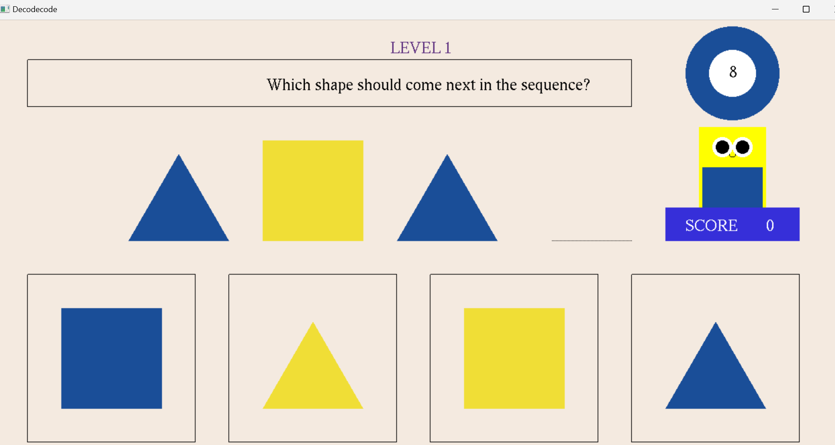
Innovative Data structures TIMING WHEEL
"Efficient Timer Management and its Applications"
Group members:
Mamoona (231662)
Maheen Fatima (231659)

Slide 2
CONTENTS:
INTRODUCTION
EXAMPLE AND EXPLANATION
REAL-LIFE APPLICATIONS
IMPLEMENTATION IN GAME
SYNTAX
ALGORITHM COMPLEXITY

Slide 3
INTRODUCTION
The Timing Wheel is an advanced data structure used to
efficiently manage multiple timers in systems where events need to
be triggered after specific time intervals.
Role:
Organizes timers into a circular array, where each slot represents a time unit (e.g., seconds).
It optimizes the process of handling multiple timer-based events, reducing the time complexity from O(n) to O(1) per timer operation.
Key Features:
Efficient event scheduling with minimal computational overhead.
Reduces system resources when managing a large number of timers.

Slide 4
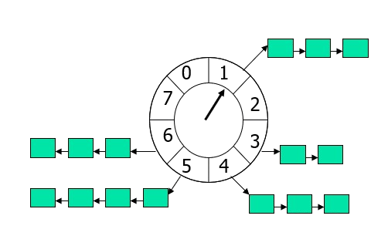
HOW IT WORKS?
Initialization: The Timing Wheel is a circular array where each slot represents a unit of time.
Event Scheduling: Timers are placed in a slot based on when they need to be triggered.
Timer Advancing: The "current time" is tracked with a pointer that moves every second, processing the events in the corresponding slot.
Event Handling: Events in the current slot are executed when the pointer reaches that slot.
Example:
Scenario: Sending notifications at 2 seconds, 5 seconds, and 8 seconds.
Instead of scanning all timers every second, the Timing Wheel efficiently places the events in the correct slots, allowing for efficient execution.

Slide 5
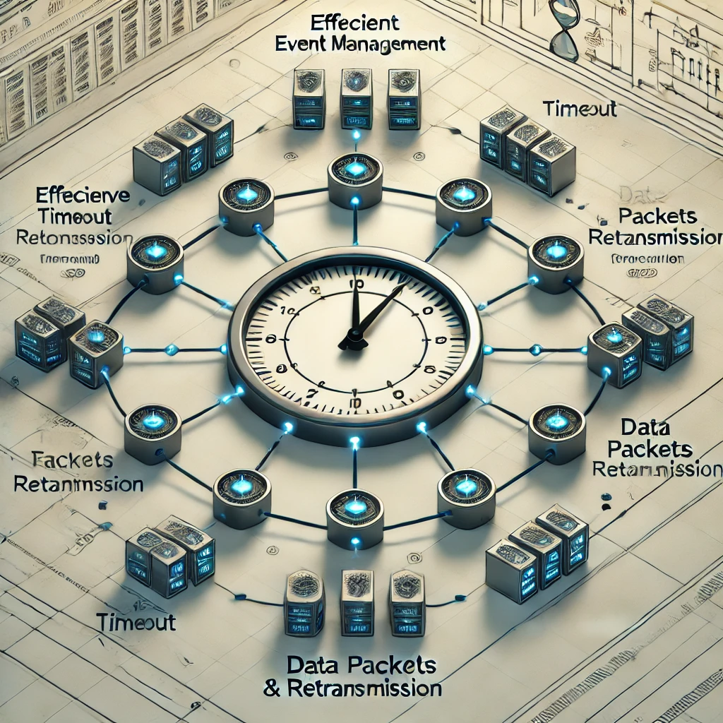

REAL LIFE APPLICATIONS
Network Protocols:TCP/IP: Manages retransmissions and timeouts for packets that did not receive acknowledgment.
Task Scheduling: Operating systems use Timing Wheels to handle background jobs and periodic tasks with efficient time management.
Real-Time Systems:Used in applications that require precise control over the timing of operations, such as robotics and automated systems.
Multimedia Streaming:In video/audio streaming, where frames must be displayed at specific intervals, Timing Wheels ensure efficient and timely delivery.

Slide 6
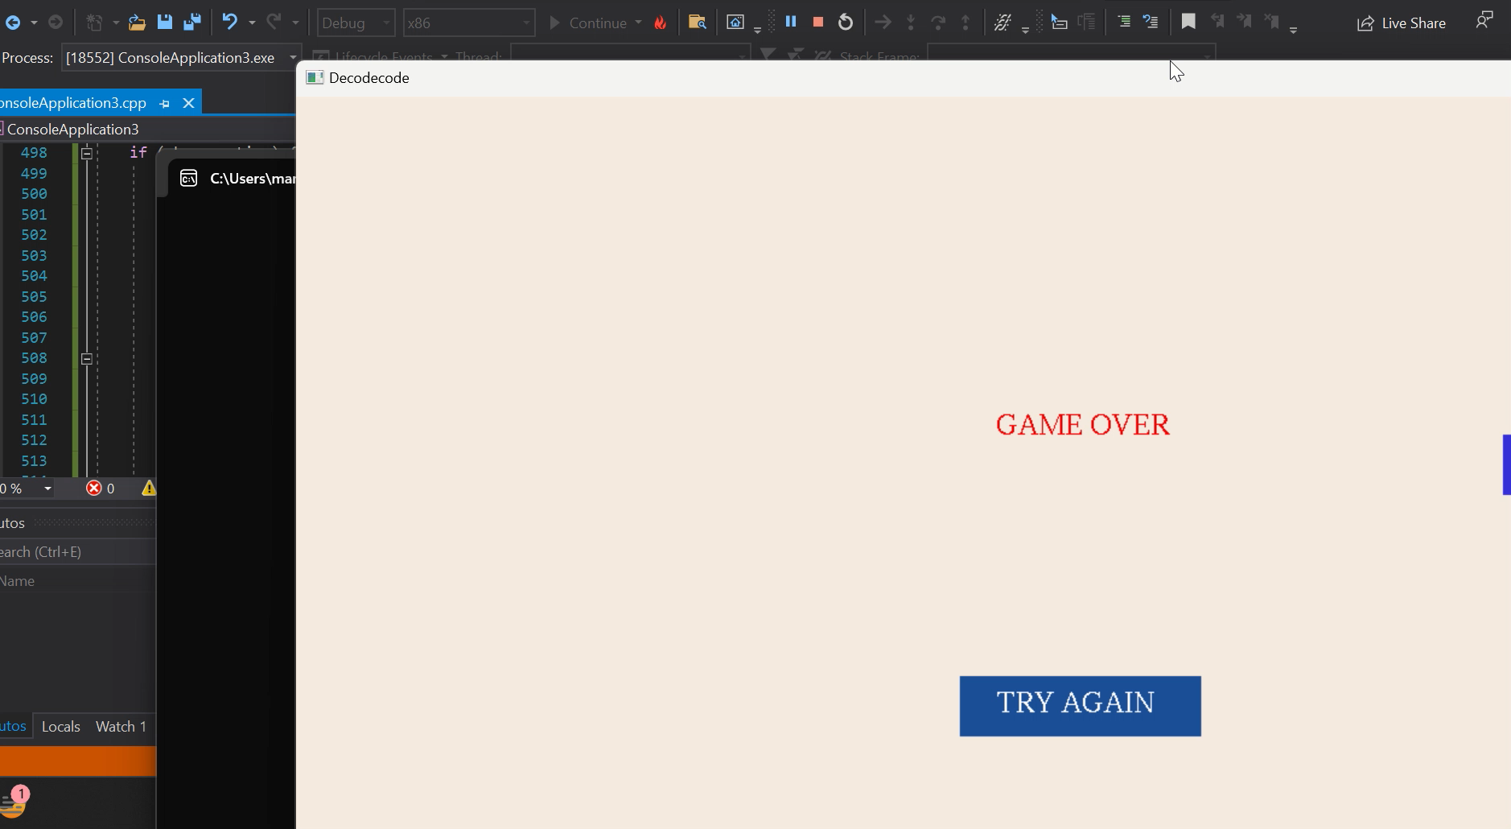
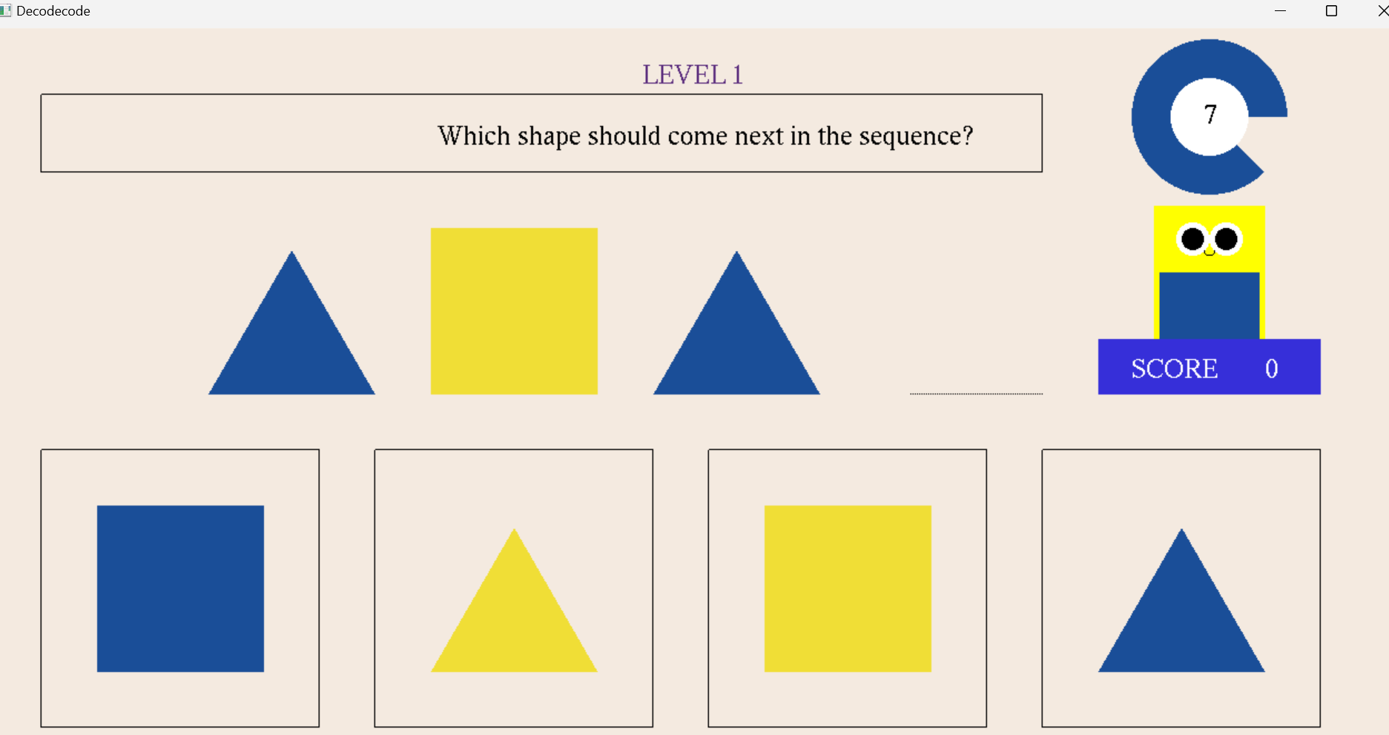
IMPLEMENTATION IN GAME
The game uses a Timing Wheel to track the time left to answer each question.
The Timing Wheel in this context tracks events (e.g., penalizing the score) based on time slots (representing seconds).
As the current time pointer moves through the slots, it ensures that the event (penalizing the score after 8 seconds) is triggered efficiently.

Slide 7
SYNTAX
void addEventToTimingWheel(int delay, const string& event) {// Add an event to the timing wheel
int targetSlot = (currentSlot + delay) % TIMER_WHEEL_SIZE;
timingWheel[targetSlot].push_back(event);
}
void processTimingWheel() {// Process events in the current slot
if (!timingWheel[currentSlot].empty()) {
for (const string& event : timingWheel[currentSlot]) {
if (event == "penalize") {
score -= 50; // Penalize score for timeout
qs++; // Move to the next question
if (qs > 9) { // No more questions left
timerRunning = false;
} else {
timerCount = 8; // Reset timer for the next question
addEventToTimingWheel(8, "penalize"); // Add new event
}
}
}
timingWheel[currentSlot].clear(); // Clear processed events
}
}

Slide 8
Algorithm Complexity
Time Complexity:
O(1) for adding an event to the wheel, as it is directly placed in the corresponding slot.
O(1) for processing events, as only the current slot is processed each time.
Space Complexity:
O(N), where N is the number of slots in the Timing Wheel (size of the array). This is the space used to store the events.
Efficiency:
Reduces the overhead of managing multiple timers and improves performance in systems that need to handle large numbers of events.

Slide 9
Conclusion
The Timing Wheel is an efficient data structure for managing time-sensitive tasks or events.
It provides O(1) time complexity for timer operations, making it scalable and efficient.
In the "DecodeCode" game, it allows for smooth and efficient timer management, ensuring accurate penalty application and question transitions.

